Slide 1

Members: Dipankar Dey Saikat Kumar Ghosh
Project Title : Bengali Handwritten Character Recognition
23/05/2024

Slide 2
What?
Objective: Develop a model using ML techniques to classify handwritten Bengali characters.
Bengali Script Details: The script consists of 11 vowels and 39 consonants, making up a total of 50 basic characters.
Approach: Utilize ML algorithms to identify handwritten characters.

Slide 3
Why?
Language Significance: Bengali's cultural heritage necessitates effective character recognition solutions.
Current Limitations: Recognition systems for Bengali lag behind than those available for other languages.
Challenges: Variations in size, shape, and writing styles complicate recognition process.

Slide 4
HOW?
Literature Review
Reading research papers and related works.
Data Collection
Collecting data for project from different sources.
Data Cleaning & Preprocessing
Removing noise and irrelevant information , and formatting for model input.
Using various supervised classification algorithms and evaluating their effectiveness.
Preparation Of Project Report
Applying ML Algorithms and Assessment of Performance

Slide 5
Timeline
Project Report Preparation
Feb 24th-March 4th
Literature Review
March 13th -20th
March 30th –April 25th
April 25th –May 1st
Applying ML Algorithms and Assessing the Performance
Data Cleaning and Preprocessing
Data Collection
March 20th -30th

Slide 6
Literature Review
A Machine Learning Approach for Bengali Handwritten Vowel Character Recognition.
A Universal Way to Collect and Process Handwritten Data for Any Language.
BornoNet : Bangla Handwritten Characters Recognition Using Convolutional Neural Network
Ekush : A Multipurpose and Multitype Comprehensive Database for Online Off-Line Bangla Handwritten Characters.
Two Decades of Bengali Handwritten Digit Recognition : A Survey

Slide 7
Data Collection
1.Ekush Comprehensive Bengali Isolated Characters Dataset.
Contains 149,456 primary Bengali Characters.
Data Source: https://rabby.dev/ekush/#external
2.BanglaLekha Isolated Dataset.
Contains some 86,458 primary Bengali Characters.
Data Source: https://data.mendeley.com/datasets/hf6sf8zrkc/2
3.Data Collected by us.
Contains 2500 primary Bengali Characters.

Slide 8
Data Preprocessing
1.For data collected from Ekush & Bangla Lekha Isolated :
Removed extra characters other than the primary 50 characters from the dataset.
Manually removed the mistakes which were there in the dataset .
Used dask for multiprocessing of the images.
Resized the images in uniform 28x28 dimension.
Created numpy files to store the whole image dataset.

Slide 9
Data Preprocessing
2.For Data Collected by Us:
We prepared a form to collect the data.
Scanned all data forms.
Used Computer Vision techniques to extract the characters from the forms.
Then we applied Otsu’s method to get the threshold and binarized the images.
Thereafter we used Gaussian filter for smoothing and inverted the image.
Stored the data into a numpy file.

Slide 10
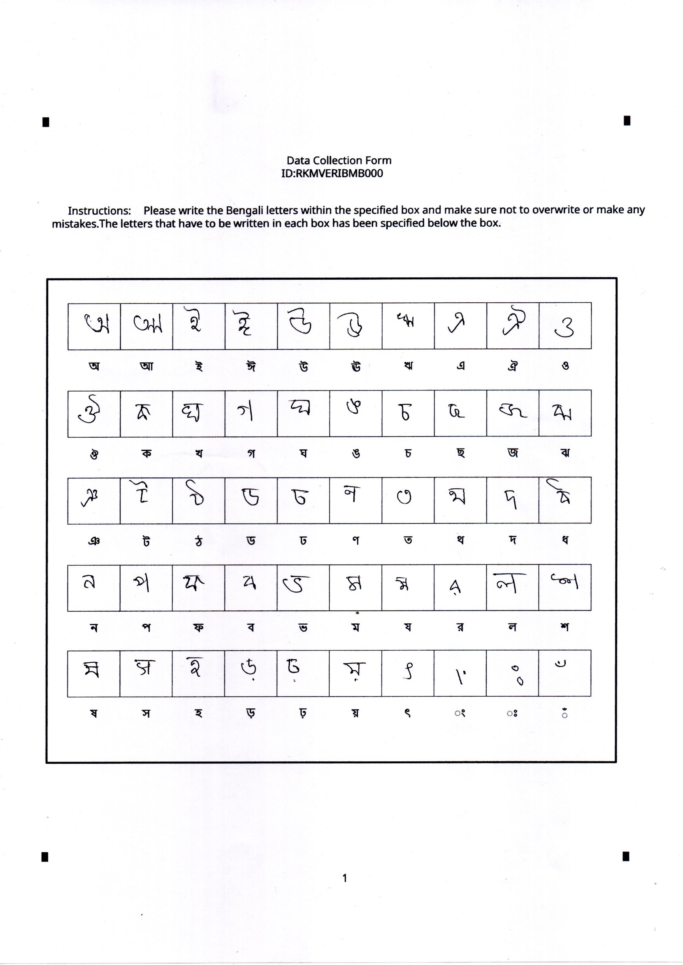
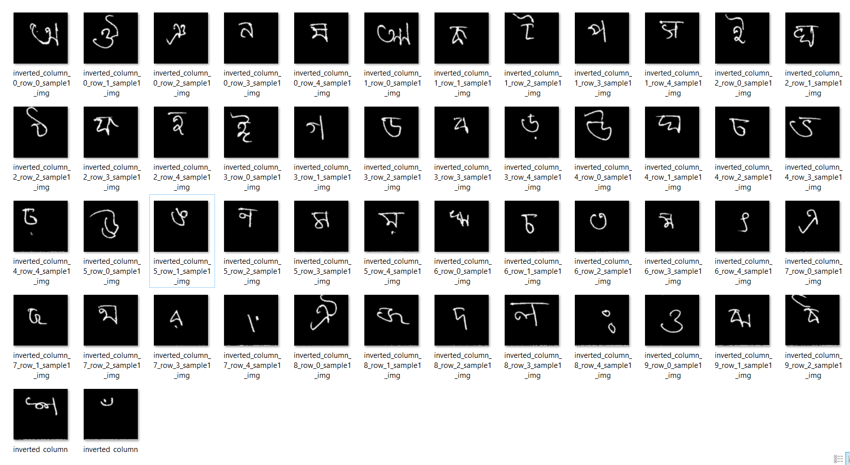
Collected Data
After data extraction

Slide 11

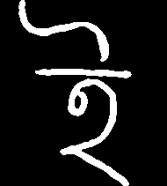
Data Samples
Ekush
Bangla Lekha Isolated
Our Dataset

Slide 12
Model Deployment
Training Dataset: Ekush Dataset.
Test Dataset: BanglaLekha Isolated, Primary dataset.
Models Used:
Logistic Regression
KNN
Naïve Bayes
Decision Tree
Random Forest
SVM(Polynomial Kernal)
SVM(RBF Kernal)

Slide 13
Model Performance Details
Experimental Results summary on Bangla Lekha Isolated:
Model Name | Accuracy(%) | Average Recall | Average Precision | Average F1 Score
Logistic Regression | 43.28 | 44.65 | 45.64 | 45.07
KNN(nn=7) | 58.64 | 57.61 | 61.55 | 58.11
Naïve Bayes | 38.04 | 37.65 | 37.82 | 37.73
Decision Tree(min sample=5,min split=10) | 24.12 | 24.88 | 25.47 | 25.17
Random Forest(380 estimators) | 51.74 | 52.26 | 57.44 | 54.64
SVM(Polynomial Kernal) | 72.34 | 73.23 | 74.19 | 73.7
SVM(RBF Kernal) | 72.81 | 74.62 | 74.76 | 74.69

Slide 14
Model Performance Details
Experimental Results summary on Primary Dataset:
Model Name | Accuracy(%) | Average Recall | Average Precision | Average F1 Score
Logistic Regression | 55.68 | 56.98 | 58.22 | 57.62
KNN(nn=7) | 62.04 | 65.71 | 72.92 | 68.92
Naïve Bayes | 47.28 | 45.92 | 54.27 | 49.72
Decision Tree(min sample=5,min split=10) | 25.48 | 23.6 | 25.66 | 24.57
Random Forest(380 estimators) | 63.36 | 68.7 | 69.94 | 69.29
SVM(Polynomial Kernal) | 86.8 | 87.92 | 89.09 | 88.48
SVM(RBF Kernal) | 88.12 | 88.28 | 89.41 | 88.84

Slide 15
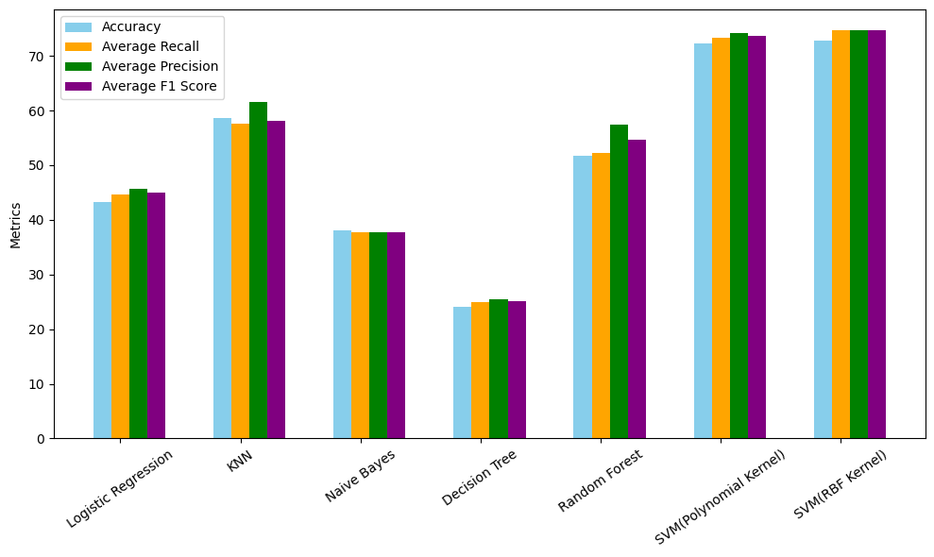
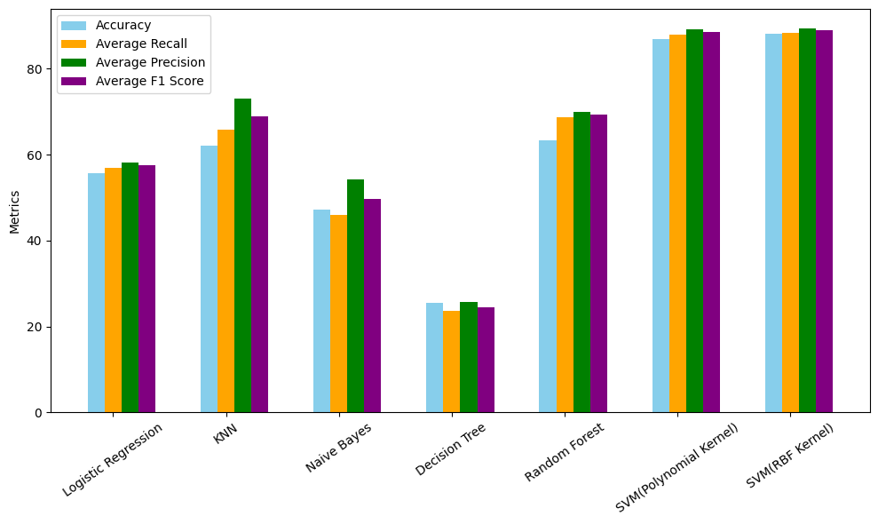
Graphical Representation
Bangla Lekha Isolated
Our Primary Dataset

Slide 16
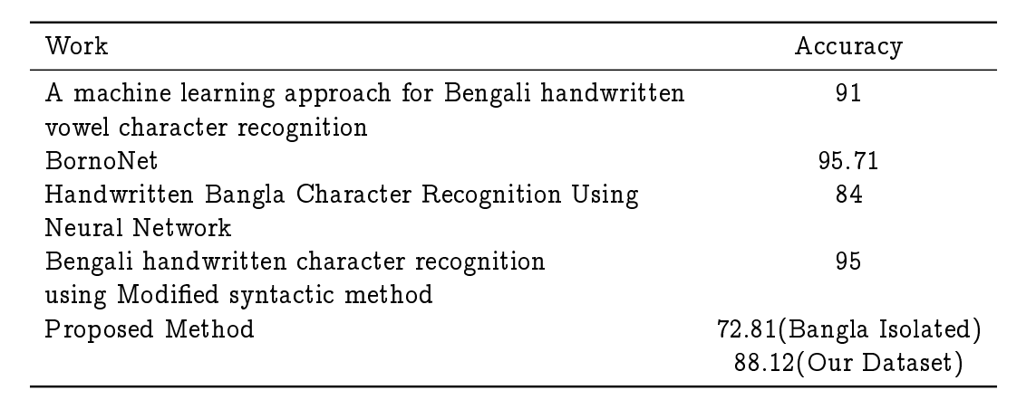
Comparison with other’s work

Slide 17
Summary:
Through this project we wanted to show the feasibility of using traditional ML models for handwritten character classification.
Our future work will consist of applying more feature extraction techniques and then to apply ML or deep learning techniques for classification to get better results.

Slide 18
References:
A Machine Learning Approach for Bengali Handwritten Vowel Character Recognition.
A Universal Way to Collect and Process Handwritten Data for Any Language.
BornoNet : Bangla Handwritten Characters Recognition Using Convolutional Neural Network
Ekush : A Multipurpose and Multitype Comprehensive Database for Online Off-Line Bangla Handwritten Characters.
Two Decades of Bengali Handwritten Digit Recognition : A Survey
Bengali handwritten character recognition using modified syntactic method. 2005.
Handwritten bangla character recognition using neural network. International Journal of Advanced Research in Computer Science and Software Engineering, 2, 2012.

Slide 19
Thank you
Dipankar Dey
dipankardey6297@gmail.com
Saikat Kumar Ghosh
saikatghosh2782001@gmail.com

